Slide 1
Business Problem
Understanding
Shahriar’s Analytical Academy

Slide 2
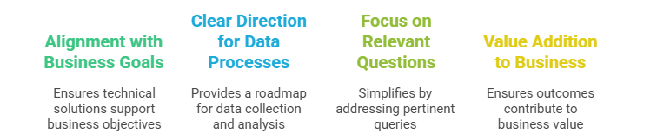
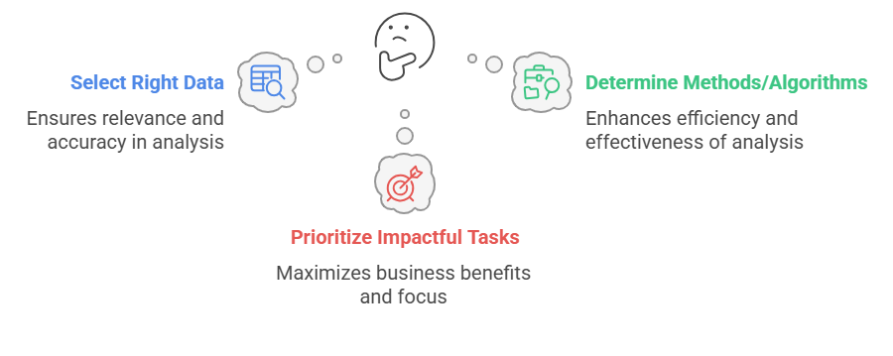
The First step of Data science Methodology
Understanding the business problem is the starting point of any data science project because it helps define the purpose, scope, and objectives of the analysis.
Notes:
In any data science project, understanding the business problem is the first crucial step. This stage is essential because it helps define the purpose and scope of the analysis. When you clearly understand what problem the business is trying to solve, you can make informed decisions about how to approach the project, from selecting the data to determining the methods and tools that will be used.
The importance of understanding the business problem is that it ensures your technical solutions align with the business's goals. Without this alignment, you risk developing a solution that may be technically sound but doesn’t address the real needs of the business. For example, if the problem is about increasing sales but you focus on optimizing inventory management instead, the business won’t see the desired impact.
Understanding the problem also provides a clear direction for data collection and analysis. It ensures that only relevant data is gathered and analyzed, preventing unnecessary complexity in the process. Focusing on the right questions ensures you don’t waste resources working on areas that won’t contribute to solving the core issue. Finally, when you understand the business problem, you’re able to ensure that the outcome of the data science work actually adds value to the business by directly addressing its needs.
Key points to remember: Understanding the business problem helps in selecting the right data, determining the methods to use, and prioritizing tasks that have the most significant business impact.

Slide 3
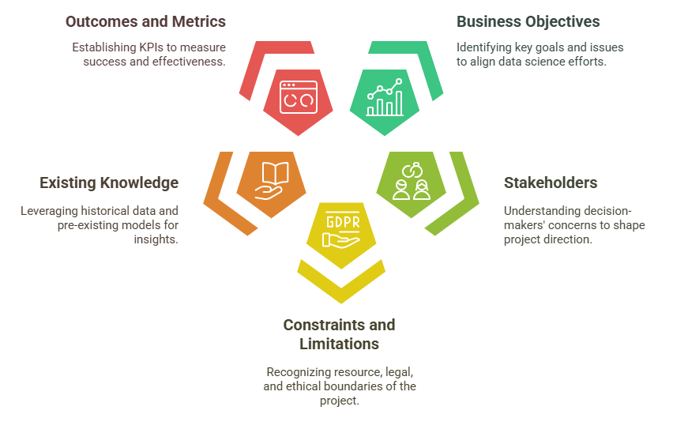
Key Factors to Consider
Notes:
When trying to understand the business problem, several factors need to be considered to ensure that you approach the issue in the best possible way.
Business Objectives: The first factor is understanding what the business is trying to achieve. What are the key goals or challenges the business is facing? For example, is the company struggling with customer retention, sales performance, or operational efficiency? Understanding these goals will help you define how data science can be applied to improve or solve these problems.
Stakeholders: It’s also crucial to identify who the decision-makers are within the business. These could be executives, managers, or team leads who have a direct interest in the project’s success. Understanding their concerns and expectations helps guide your approach. Knowing their priorities ensures you tailor the solution to meet their needs and objectives.
Constraints and Limitations: Every project has constraints—whether it’s limited resources, budget, or time. Understanding these limitations is vital to ensure you don’t commit to goals that aren’t feasible. Moreover, there may be ethical, legal, or privacy concerns that could restrict how you can use or collect data. These factors must be taken into account to avoid any future issues.
Existing Knowledge: Before diving into new data, you must also look at what existing knowledge or data is available. Are there historical insights or previous models that could help inform the current project? Understanding the current landscape will help you avoid duplicating work and leverage what’s already been learned.
Outcomes and Metrics: Finally, it’s important to understand how success will be measured. What metrics or key performance indicators (KPIs) will determine if the solution works? This could be sales growth, customer satisfaction, or efficiency improvements. Clear outcomes help set the direction for the data science solution and ensure it’s aligned with the business's expectations.

Slide 4
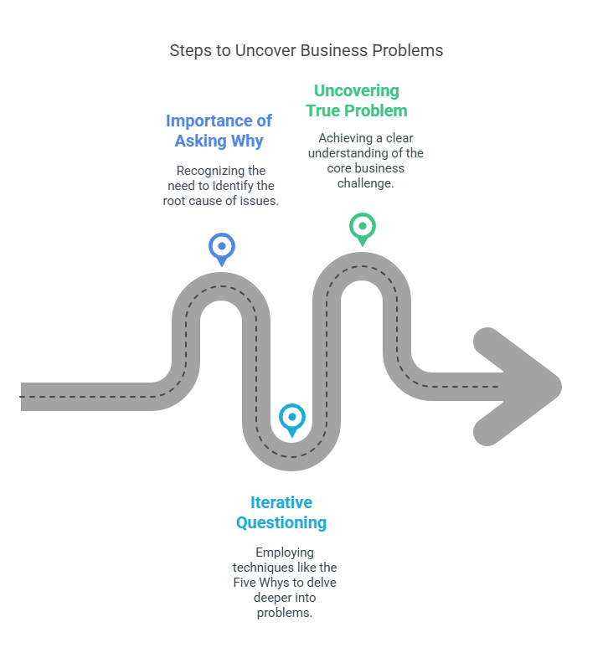
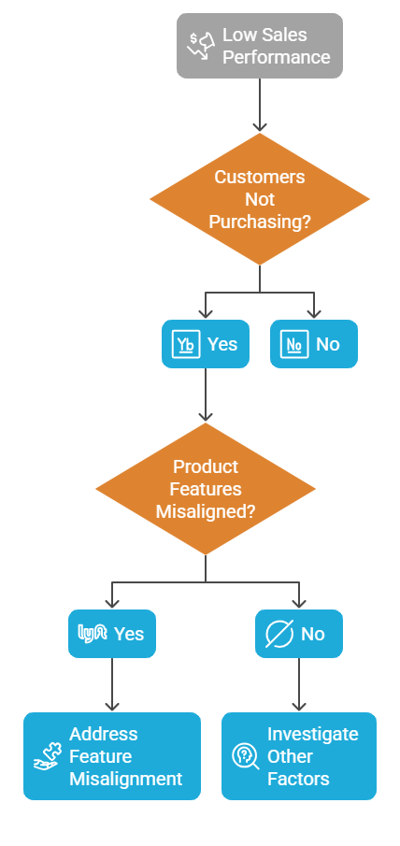
The use “Why” to find the core problem
Notes:
The key to identifying the true business problem is asking "Why." This process helps uncover the root cause rather than just treating surface-level symptoms. When you ask "Why" repeatedly, you get closer to the underlying issue, allowing you to address the core problem with a more effective solution.
Iterative Questioning: One technique to explore deeper layers of the problem is the "Five Whys." This involves asking "Why" multiple times to get to the root cause. For example:
“””Explain the flow chart””””
By asking these follow-up questions, you reveal the true nature of the problem: the product’s features may not be meeting customer expectations, which is the root cause of the low sales. This process helps you avoid focusing on superficial issues (like poor marketing or pricing) and instead develop a data-driven solution that directly addresses the real problem.
Asking "Why" several times helps ensure your data science work is rooted in solving the actual business problem, leading to more focused and effective solutions.

Slide 5
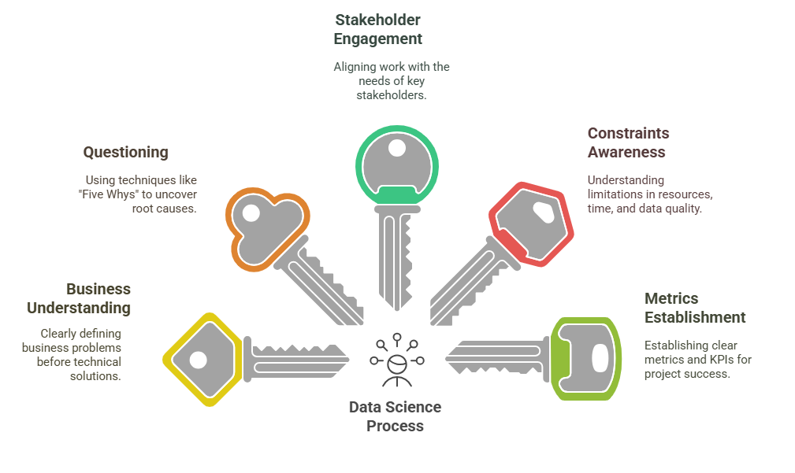
5 Key Learning Points of this Lesson
Notes:
Data Science Starts with Understanding Business Needs: Before diving into the technical aspects, always make sure you have a clear understanding of the business problem. This helps you tailor your analysis and solutions to what the business really needs.
Ask the Right Questions: Techniques like the "Five Whys" are essential for uncovering the root cause of a business problem. Don’t settle for surface-level issues; dig deeper to ensure you address the core problem.
Stakeholder Engagement: Identify and understand your stakeholders. Their concerns and objectives will shape your approach and help you prioritize the right tasks. Stay aligned with their goals throughout the project.
Constraints and Limitations Matter: Always consider the resources, time, and budget constraints you face, as well as any legal or ethical issues related to the project. These factors will influence the scope and feasibility of your solution.
Metrics Are Critical: Define clear metrics and KPIs at the outset to measure the success of your data science solution. Without these, it’s difficult to evaluate whether your efforts have truly solved the business problem.

Slide 6
Thank You!
Shahriar’s Analytical Academy

